Slide 1












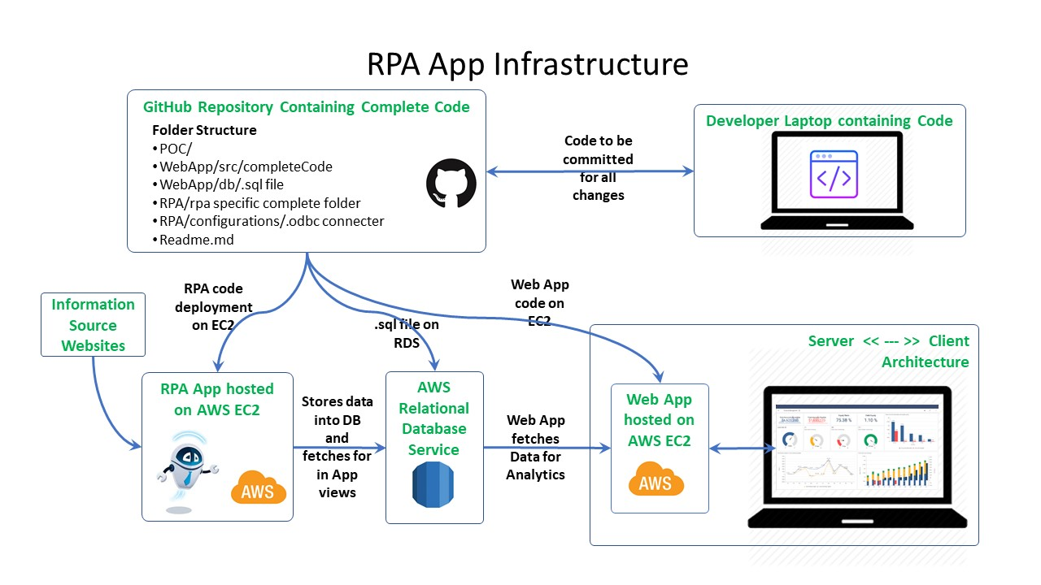


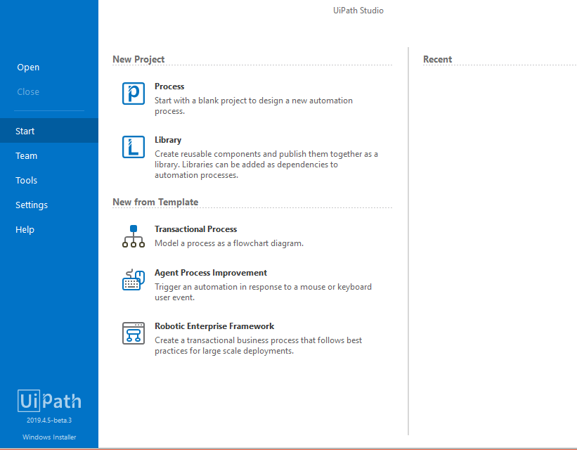
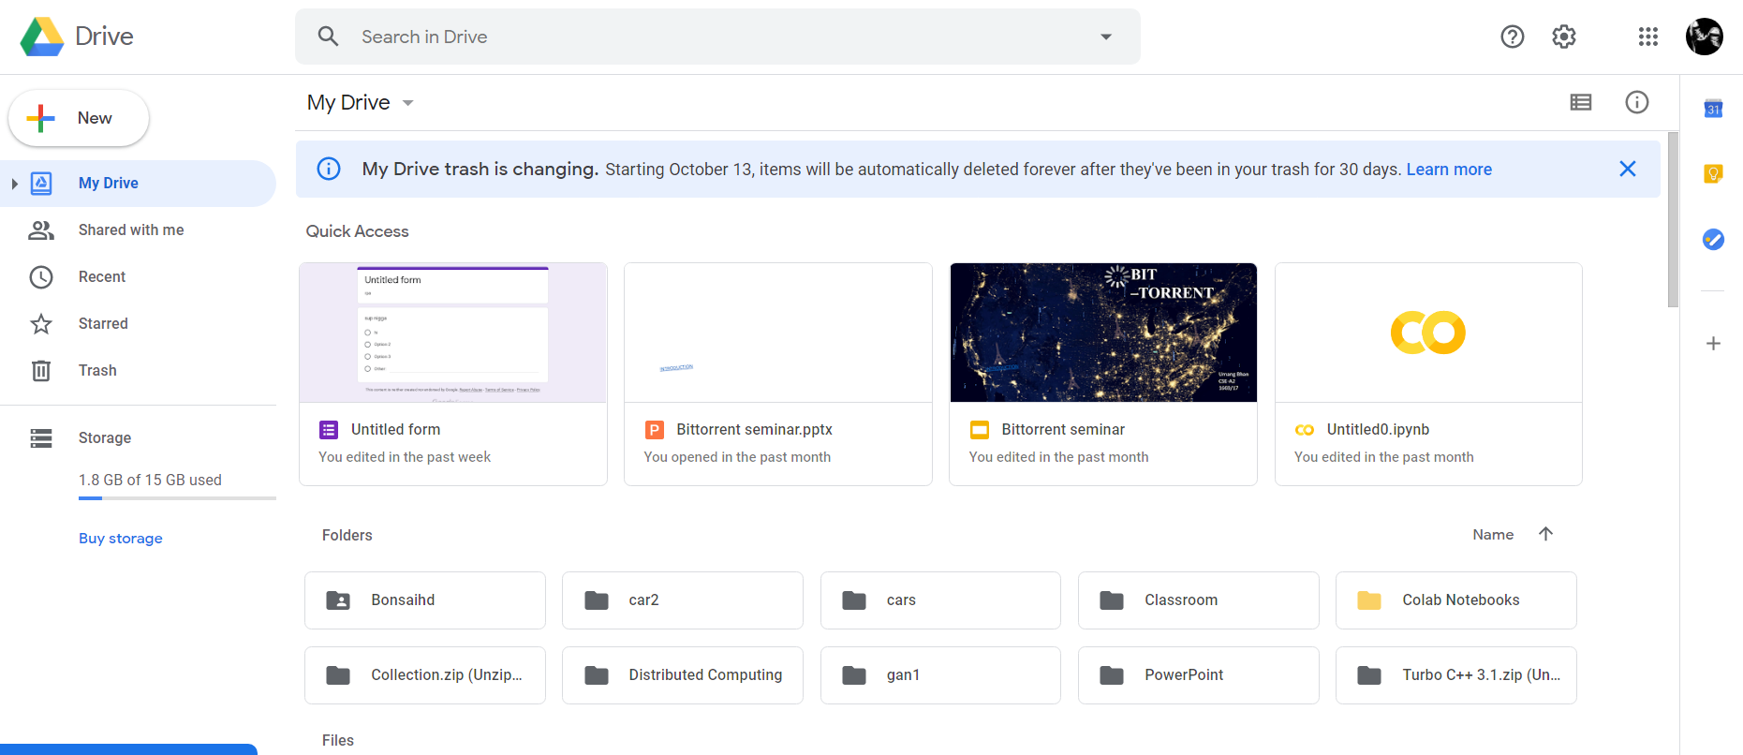
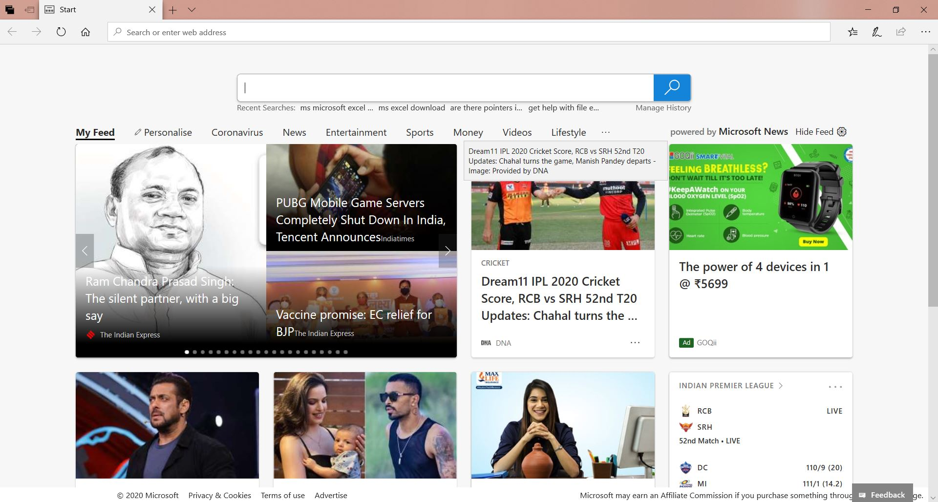
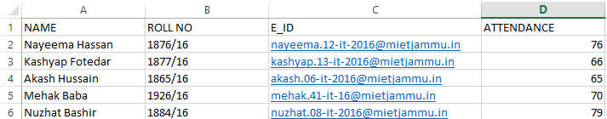

[FACULTY ASSISTANT]
[Raghav Gupta|Umang Bhan|Vastvik Upadhaya|Samarkant Bhasin|Sahil Singh]
raghav.81-cse-17@mietjammu.in umang.75-cse-17@mietjammu.in, vastvik.97-cse-17@mietjammu.in samarkant.118-cse-17@mietjammu.in sahil.66-cse-17@mietjammu.in
Abstract
Entity Relationship Diagram / Data Processing workflow
During this covid-19 period, the education department has suffered a lot as all the schools and colleges were closed due to the fear of the pandemic. But education is a necessary part of our life, henceforth some way has to be found to tackle the problem. The best way of tackling the problem is using the online classes for teaching and google classroom etc., as a way for assignments. However, the teachers are equipped with a lot of work and in addition to that they also have to look for other things such as tasking note of the courses done by students, whether students have applied for jobs etc. So, to solve this problem we have designed an RPA bot that will act as a faculty assistant to teachers.
Student
Admin
s_name varchar(8)
ad_name varchar(9)
s_rollno int
ad_id int
s_email varchar(8)
ad_email varchar(9)
s_attendance int
ad_pno int
Innovation & Impact
Staff
STAFF
INNOVATION:
RPA based system is automatic, fast, reliable, intelligent and manageable.
IMPACT:
Scheduled system of sending emails or other stuff on the command of user.
It reduces time, cost and expenditures.
Efficient planning and shift management.
An automated faculty assistant will help in various stuff such as in case of relaying information to students about their progress in respective courses.
It will furthermore check for items such as synopsis and ppts if the students have uploaded any.
st_name varchar(8)
st_id int
st_email varchar(9)
st_sub varchar(8)
st_pno int
Use Cases | Functional Workflow
Architecture Diagram
Website
Download
Excel Sheets from system or google drive
UiPath
Chat-Bot
Web App hosted
on AWS EC2
Excel Sheet
Interface(PC)
Performing Tasks
Staff
Screen Flow | Interaction Model
UiPath Bot
RPA App hosted
on AWS EC2
Technology - Robotic Process Automation
Language - VB.Net
Development Tool - UiPath
Deployment Tool – UiPath
Python, MySQL, Google Sheets API
Checking for ppts and synopsis and course completion
Course completion google sheet URL
Website
Language(s) | API(s) | Technology Stack
Task completion
Project Code: - CSE(A2)_P7

